Slide 1
Writing in The Technical Fields (Ch.4~6 & Ch.14~16)
2020-08-03
Presenter: Cheng-Yuan Wang
The Electronic Design Automation Laboratory
Graduate Institute of Electronics Engineering
National Taiwan University
Taipei 106, Taiwan

Slide 2
Outline
Chapter 4 : Using the Computer to Improve Your Writing
Chapter 5 : Improving the Coherence of Your Writing
Chapter 6 : Writing Better Paragraph
Chapter 14 : Procedures and Manuals
Chapter 15 : Formal Elements of Reports
Chapter 16 : Proposals

Slide 3
Outline
Chapter 4 : Using the Computer to Improve Your Writing
Chapter 5 : Improving the Coherence of Your Writing
Chapter 6 : Writing Better Paragraph
Chapter 14 : Procedures and Manuals
Chapter 15 : Formal Elements of Reports
Chapter 16 : Proposals

Slide 4
Chapter 4: Using the Computer to Improve Your Writing
Goal : Some basic ways to use the computer as a tool during the different stages of the writing process.
– Understand What the Computer Can–and Cannot–Do for You
– Use the Computer When You’re just Getting Started on a Document
– Use the Computer When You‘re Revising
– Use Specialized Software

Slide 5
Understand What the Computer Can–and Cannot–Do for You
Increase your writing productivity significantly
Eliminate misspellings and grammar mistakes
Produce professional-looking document in much less time
Notes:
Computer cannot think, cannot write
woodworking

Slide 6
Use the Computer When You’re just Getting Started on a Document
Text-moving function
Make copies easily for everyone
Idea-generating techniques
– Sketching
Notes:
3. graphic software

Slide 7
Use the Computer When You’re Revising
Your writing is legible
Give you a more objective perspective on your work
Redline
– Make it easier to identify the revisions
Notes:
legible: 字跡易辨讀的 不用擔心自己字跡潦草
以更客觀的觀點看，就跟他人的一樣

Slide 8
Outline
Chapter 4 : Using the Computer to Improve Your Writing
Chapter 5 : Improving the Coherence of Your Writing
Chapter 6 : Writing Better Paragraph
Chapter 14 : Procedures and Manuals
Chapter 15 : Formal Elements of Reports
Chapter 16 : Proposals

Slide 9
Chapter 5: Improving the Coherence of Your Writing
Goal : Some techniques for leading readers where to begin and being better able to concentrate on the information.
– Write Informative Titles and Headings
– Use Lists to Communicate Parallel Information
– Use Introductions to Forecast Discussion
– Use Conclusions to Complete Discussions
Notes:
Coherence 連貫性

Slide 10
Write Informative Titles and Headings
Write sufficiently precise
– Imprecise : Enhancing Production
Precise : Three Techniques for Enhancing Production in the Zuma Copper Mine
Avoid the noun strings
– Unclear : Shipboard Corrosion-Prevention Techniques Task Force Meeting Minutes
Clear : Meeting Minutes for the Task Force on Shipboard Corrosion-Prevention Techniques
Using “How to” form is effective for instructions
– How to Attach the Optional Paper Tray to the Printer
Notes:
3.
Besides, Questions work well
for less-knowledgeable readers
(Ex: What, Why … )

Slide 11
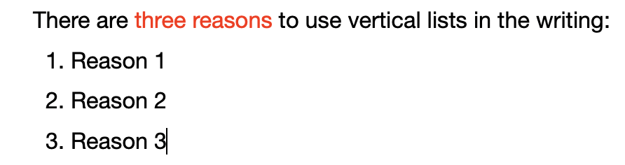
Use Lists to Communicate Parallel Information
Use vertical lists enables readers to concentrate better on the information
Bullets are more often appropriate than numbers in vertical lists.
– Numbers are often used in sequencing or priority

Slide 12
Use Introductions to Forecast Discussion
What is the purpose of the discussion?
– Readers need to know what you intend to do in discussion
What is the background of the subject?
– The background is the information readers need to understand the discussion
What is the scope of the discussion?
– The scope of a discussion is its territory: what is included and what is excluded
What is the organization of the discussion?
What are the key terms that will be used in the discussion?
Notes:
Background:
Use Appendix to help the reader cross to another location in the document for a fuller discussion

Slide 13
Use Conclusions to Complete Discussions
What are the main points established in the document?
– Summarize the important ideas in a paragraph for the readers
What should be done next?
– Future work
How can the reader find out more information?
How can we help you in the future?
Notes:
1. For the readers who forget some of the material, especially from the beginning
3. Help readers understand how to get more information
4. Conclude with an offer to provide future services

Slide 14
Outline
Chapter 4 : Using the Computer to Improve Your Writing
Chapter 5 : Improving the Coherence of Your Writing
Chapter 6 : Writing Better Paragraph
Chapter 14 : Procedures and Manuals
Chapter 15 : Formal Elements of Reports
Chapter 16 : Proposals

Slide 15
Chapter 6: Writing Better Paragraphs
Goal : An effective paragraph helps the readers make the transition from one sentence to the next.
– Begin with a Clear Topic Sentence
– Support the Topic Sentence Logically
– Emphasize the Coherence of the Paragraph
– Keep Paragraphs to a Manageable Length

Slide 16
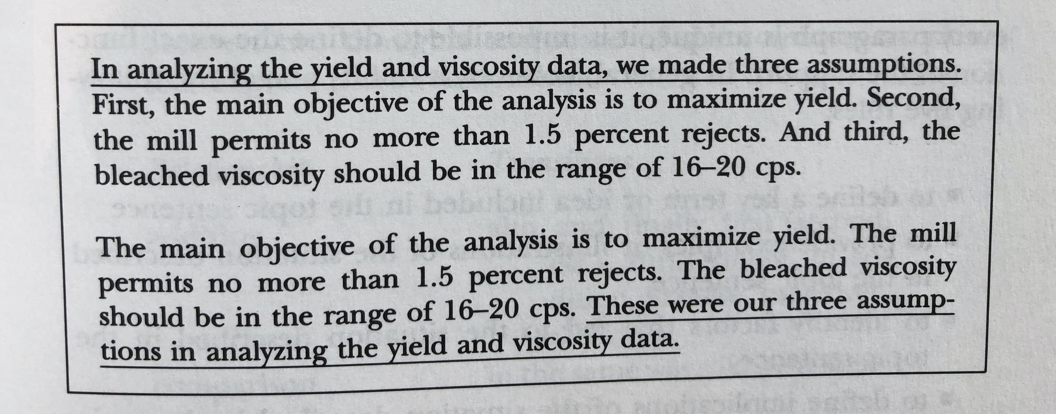
Begin with a Clear Topic Sentence
“Topic Sentence” is the major idea of a paragraph
– States explicitly or forecasts the main idea

Slide 17
Support the Topic Sentence Logically
Make the topic sentence clear and convincing
– Define a key term or idea included in the topic sentence
– Provide examples or illustrations of the situation described in the topic sentence
– Identify factors that led to the situation described in the topic sentence
– Define implications of the situation described in the topic sentence
– Defend the assertion made in the topic sentence
Notes:
Support: the body of paragraph
通常body paragraph會滿足以下五個rule 的其中之一

Slide 18
Emphasize the Coherence of the Paragraph
Use your key terms consistently
– Help readers follow your train of thought
Use transitional words and phrases pointing out the direction a thought is following
– Help readers concentrate you’re saying without having to worry about where you’re going
Use demonstrative pronouns sometimes serve as adjectives modifying a noun rather than stand alone as pronouns.
– New research techniques are being developed … These are the subject of a new search
These → These techniques
Notes:
1. Using repetition of key words(N., V.)
2.
Addition: First, furthermore, in addition
Comparison: Likewise, similarly
Contrast: But, however, on the other hand
Conclusion: Finally, to summarize, at last
The best location for the link is the beginning of the new paragraph
3.
Pronouns: this, that, those, these

Slide 19
Outline
Chapter 4 : Using the Computer to Improve Your Writing
Chapter 5 : Improving the Coherence of Your Writing
Chapter 6 : Writing Better Paragraph
Chapter 14 : Procedures and Manuals
Chapter 15 : Formal Elements of Reports
Chapter 16 : Proposals

Slide 20
Chapter 14: Procedures and Manuals
Goal : A “Procedure” is a brief description of how to carry out a task. A “Manual” is like a long procedure in that usually it describes how to carry out tasks.
– Emphasize Safety
– Orient the Reader
– Write Clear Instructions
– Design the Document for Easy Use In the Field
– Anticipate the Need for Updates
– Include Troubleshooting Tips

Slide 21
Emphasize Safety
Write the Safety Information
– Danger, Warning, Caution, Note
Create a Design for the Safety Information
– The more critical the safety comment, the larger and more emphatic it should be.
Place the Safety Information in Appropriate Locations
– Put safety information whether you think the reader is likely to see it
Notes:
1.
Danger: Likelihood of serious injury, including death
Warning: Potential for minor, moderate, or serious injury
Caution: Potential for damage to equipment
Note: A suggestion or tip on how to carry out a task
2.
Use visual symbols to accompany their different levels of comments
3.
A reasonable amount of repetition may be very effective.

Slide 22
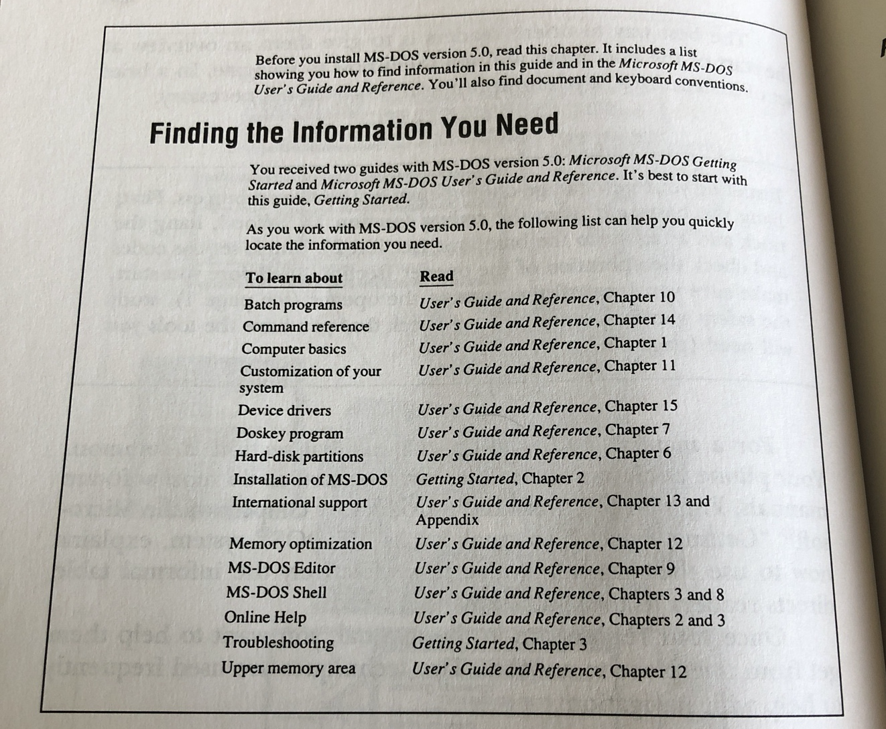
Orient the Reader
Cross Referencing
– Remind the readers of how to get back to the information they need
Visual Patterns
Notes:
There are two techniques used to help readers navigate from one place to another in the manuals

Slide 23
Write Clear Instructions
Use the Imperative Mood
– The imperative is clearer and shorter than the indicative mood
Put an Appropriate Amount of Information in Each Step
– Don’t overload an individual step with too much information
Don’t Remove the Articles
– Sometimes we cannot tell without the correct and careful use of an article
Don’t Remove the Pronouns
– Clearly explaining reduces the chance of confusion and make the writing easier to read
Notes:
1.
The imperative words: should, must
2.
Unable to read, understand and remember clearly
3.
In highly technical writing
Ex: “Book” -> noun, verb, adjective

Slide 24
Design the Document for Easy Use In the Field
Size of the document
Type of paper
Type of binding
– Loose-leaf notebooks
Design of the pages
Size of the type
Notes:
Since the readers might not be able to hold the document with both hands or place it on a table

Slide 25
Anticipate the Need for Updates
Binding
– Choose loose-leaf binding, if you anticipate revising a long document
Pagination
– Make document updating easier to add a page without having to renumber
Notes:
Two aspects of design are particularly important in planning for an update

Slide 26
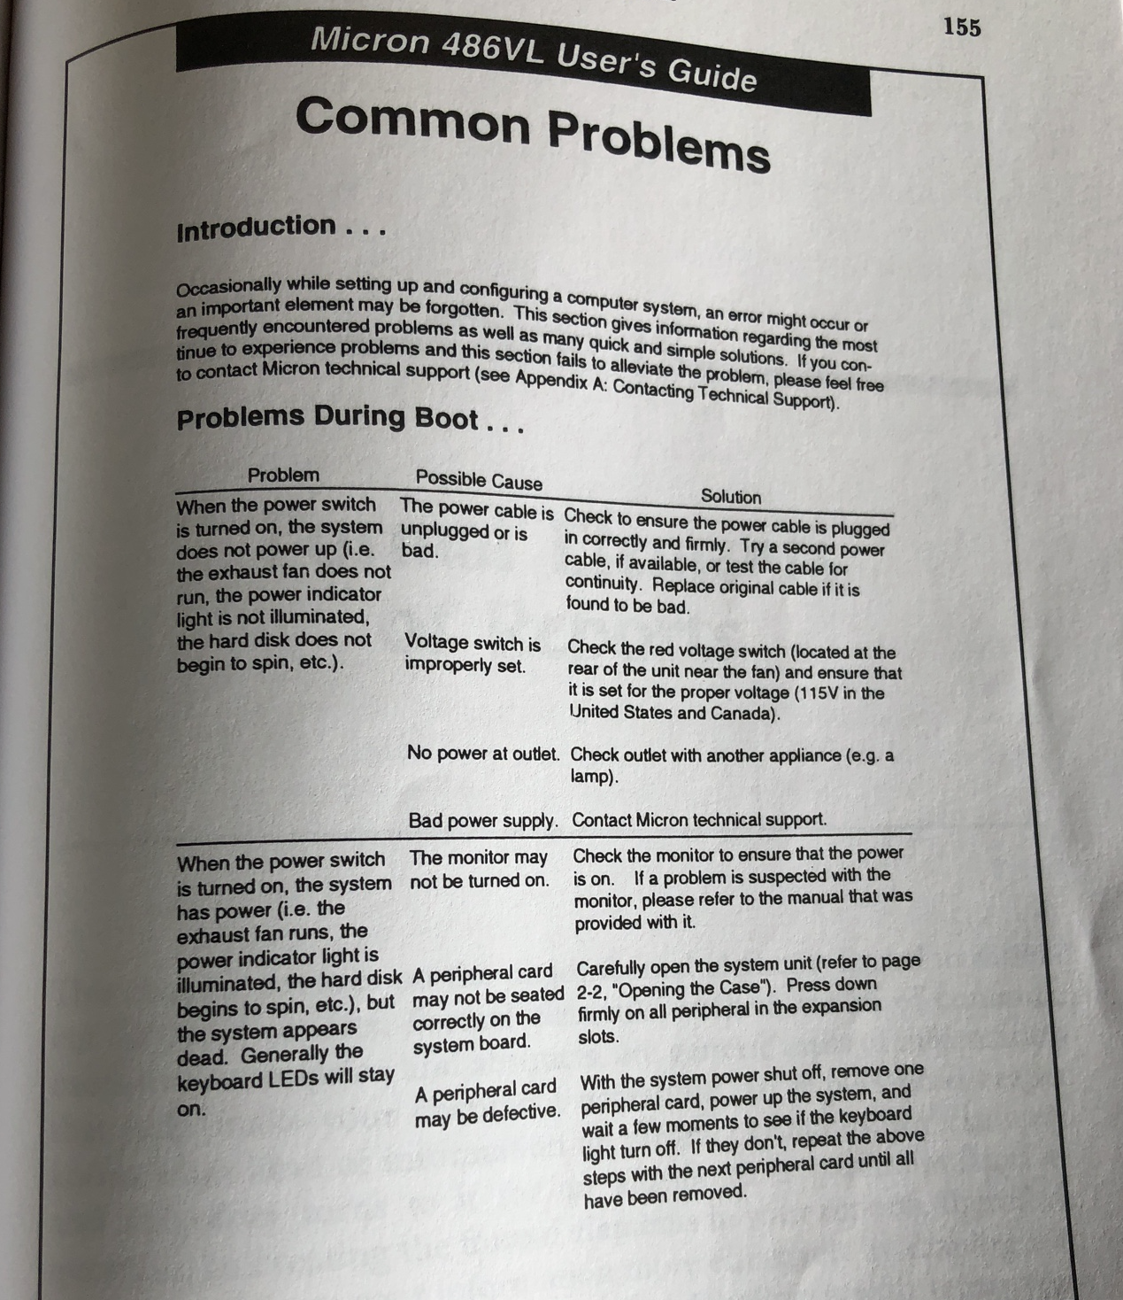
Include Troubleshooting Tips
Use the troubleshooter’s guide
Notes:
An effective conclusion for a procedure or a manual uses the troubleshooter’s guide.

Slide 27
Outline
Chapter 4 : Using the Computer to Improve Your Writing
Chapter 5 : Improving the Coherence of Your Writing
Chapter 6 : Writing Better Paragraph
Chapter 14 : Procedures and Manuals
Chapter 15 : Formal Elements of Reports
Chapter 16 : Proposals

Slide 28
Chapter 15: Formal Elements of Reports
Goal : Formal elements(tables of contents, executive summaries, abstracts) help readers make your document accessible and communicate with your readers.
– Transmittal Letter
– Title page
– Table of Contents
– Abstract
– Executive Summary
– Appendices
Notes:
accessible 易理解的

Slide 29
Transmittal Letter
The transmittal letter defines the subject of the report and indicates that the report is enclosed
The body of the letter represents the problem or opportunity and the major findings
The final paragraph is a courteous statement
Notes:
The transmittal letter begins with a brief paragraph.
X
Your willingness to answer any questions raised by the report

Slide 30
Title Page
Title
– Make clear the subject and purpose of the report
Names of the writer and the principal reader
– Commonly written about two-thirds of the way down the page in smaller type than the title
Date
Notes:
3. The date of submission of the report is added a few lines below the names of the writer and the principal reader

Slide 31
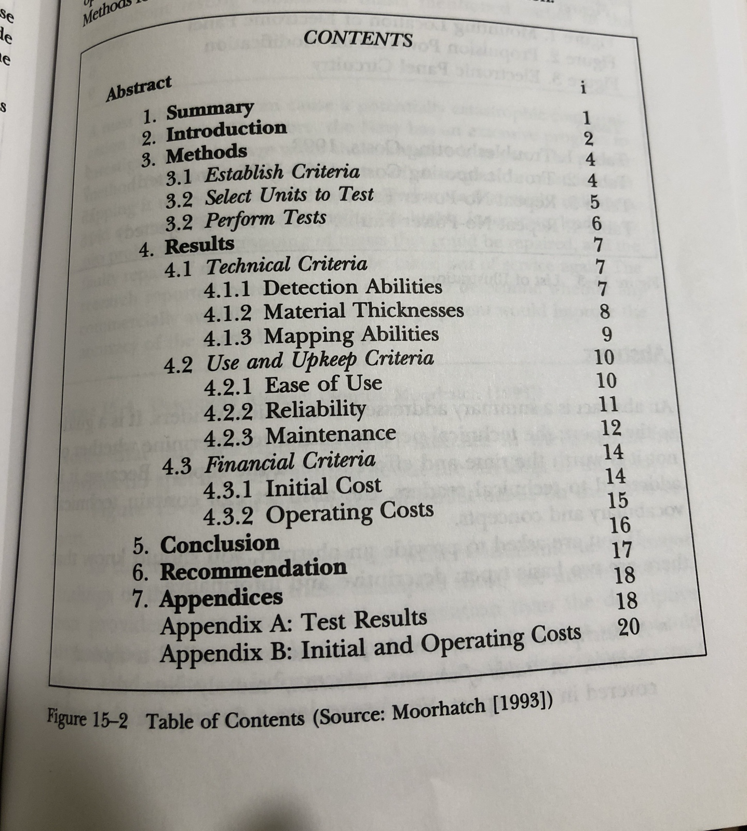
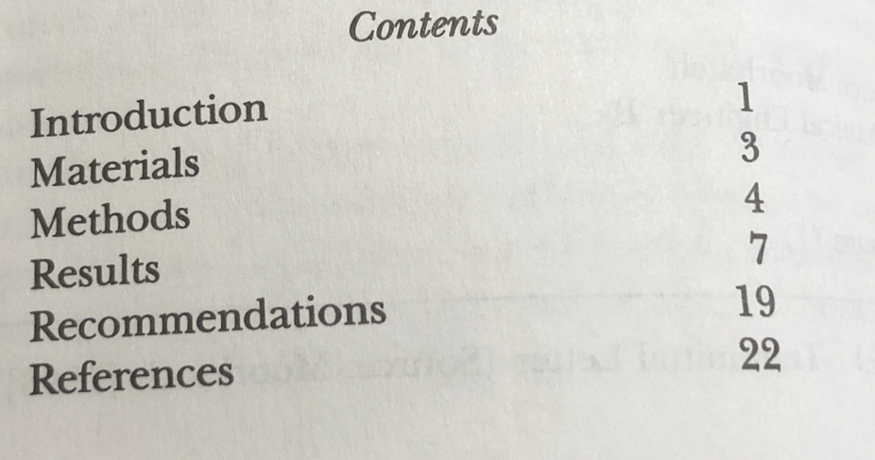
Table of Contents
Headings and sub-headings enables the readers find what they’re looking for

Slide 32
Abstract
Descriptive
– Sometimes called topical, indicative or table-of-contents abstract
– What is the scope of the report?
Informative
– Summarizes the important information in the report, emphasizing the results, conclusions and recommendations
– What are the important points made in the report?
Notes:
A summary. The technical person 決定是否要花時間或努力去讀下去

Slide 33
Executive Summary
Purpose
– A substitute for the report itself
Content
– Avoid technical vocabulary and concepts
Notes:
執行摘要
The executive summary focuses less on the technical information.
The readers might not have time, the expertise, or the need to read the full document.

Slide 34
Appendices
Writer are much more selective
– Ex: Appendix 3, page 18
Notes:
Today the average report is shorter than it used to be, but it has far more appendices
1.
No need to prove every point to their readers in the body so that the body of the report is not interrupted by extensive details

Slide 35
Outline
Chapter 4 : Using the Computer to Improve Your Writing
Chapter 5 : Improving the Coherence of Your Writing
Chapter 6 : Writing Better Paragraph
Chapter 14 : Procedures and Manuals
Chapter 15 : Formal Elements of Reports
Chapter 16 : Proposals

Slide 36
Chapter 16: Proposals
Goal : A proposal, an offer to perform a task, helps you receive time and resources to carry out the project.
– Plan Before You Start Writing
– Show that You Understand the Readers’ Need
– Propose a Clear, Specific Technical Plan for the Project

Slide 37
Plan Before You Start Writing
Analyze the readers
– What do the issuers say they want, and what can you infer they want?
– What are their priorities among all the characteristics they list?
– How will they evaluate the proposal?
Analyze your resources
– What resources (personnel, equipment, management plans … ) will you need to acquire or create?
– How much time & money will you need to put together a good proposal?
Create a plan for writing the proposal
– Who should do what task?
– What will the different people need to carry out their tasks?
– When must the task be completed?
Notes:
In the case of proposal writing, “planning” is especially important
1.
If you have an RFP (Request for a proposal),
2.
Once you have decided what your readers really want, determine whether your organization can fulfill those needs.
3.
If you have concluded that the proposal would have a good chance of success, write a detailed plan for creating the proposal.

Slide 38
Show that You Understand the Readers’ Need
There is no need to waste time repeating those the readers already understand
Cannot figure out the readers’ needs
The writer really doesn’t know how to respond to the readers’ needs
Notes:
The first and the most crucial challenge
It seems simple to meet the readers’ need; however, the writers fail so fundamentally
3. Sometimes the writer realize that the proposal won’t meet the readers’ needs but hopes to come closer

Slide 39
Propose a Clear, Specific Technical Plan for the Project
What
– What precisely are you going to provide?
– What will be its scope? Purpose? Organization? Length?
Why
– Why do you want to do this project this way?
How
– What will be your methods for carrying out the project?
Who
– Who will be performing the work?
Where
– Where you perform the tasks that make up the project?
When
– When will you perform the various tasks involved in the project?
Notes:
2. Why (strategy)
Refer to the professional literature, the trade magazines, and your own experience in similar projects to make the case
3.How(tactics)
The more detailed you can be in describing the methods, the more professional you appear
4.Who
Describe the role of each important participant, if the project involves more than one person
5.Where
Are your facilities– labs, equipment …– adequate for the job?
Often these questions are answered in an appendix.
6.When
Gantt charts, horizontal bar charts

Slide 40
Thank You For Listening

